Slide 1


Department of CSE
DESIGN AND ANALYSIS OF ALGORITHMS
24CS2203
Topic:
Knapsack Problem
Greedy Method

Slide 2
Knapsack Problem
The knapsack problem or rucksack problem , problem Given a set of items, each with a weight and a value, determine the number of each item to include in a collection so that the total weight is less than or equal to a given limit and the total value is as large as possible.
We are give n objects and a knapsack or bag .
Object i has a weight w_{i} and the knapsack has a capacity m.
If a fraction x_{i ,} 0 <x_{i} < 1, of object i is placed into the knapsack, then a profit of p_{i} x_{i} is earned.
The objective is to obtain a filling of the knapsack that Maximizes the total profit earned.

Slide 3
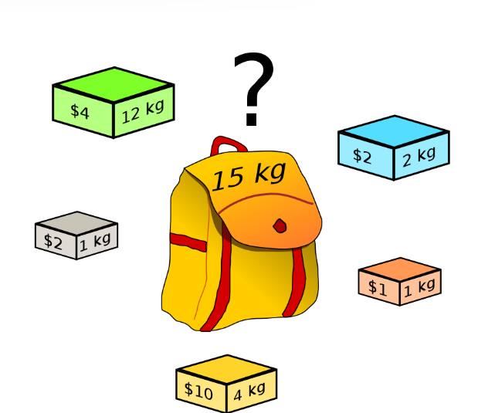

Slide 4
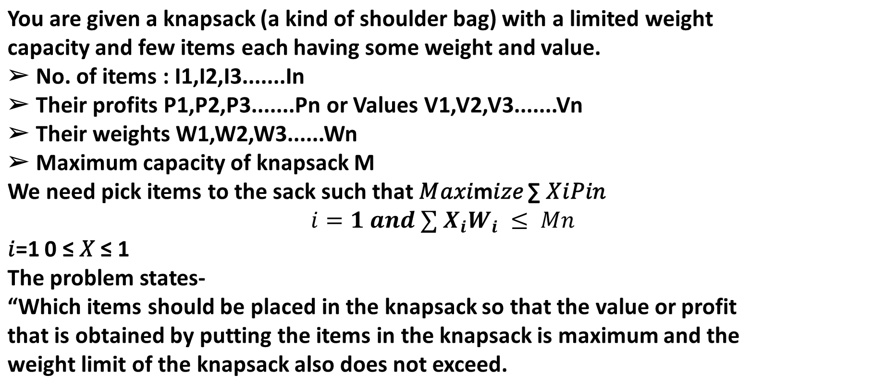

Slide 5
Knapsack Problem Variants: Knapsack problem has the following two
variants
1. 0/1 Knapsack Problem
➢ Items are indivisible i.e. we can not take the fraction of any item.
➢ We have to either take an item completely or leave it completely.
➢ It is solved using a dynamic programming approach.
2. Fractional Knapsack Problem
➢ Items are divisible here.
➢ We can even put a fraction of any item in the knapsack if taking the complete item is impossible.
➢ It is solved using the Greedy Approach.

Slide 6
Steps for Fractional Knapsack Problem Using Greedy Method:
Step-01: For each item, compute its value/weight ratio.
Step-02: Arrange all the items in the decreasing order of their value/weight ratios.
Step-03: Start putting the items in the Knapsack beginning with the item with the highest ratio. Put as many items as you can in the Knapsack

Slide 7
Solution:1
Objects are arranged in decreasing order of
profits : x₁,x₂,x₃
Selection Vector (x₁,x₂,x₃) : (1,2/15,0)
∑ w_{i}x_{i} = ( 1*18+ 2/15*15+0*10) = (18+2+0) = 20
Profit = ∑ p_{i}x_{i =} (1 *25+ 2/15 *24+0*15) = (25+3.2+0) = 28.2
Objects | Profit (p_{i}) | Weight (w_{i})
A | 25 | 18
B | 24 | 15
C | 15 | 10
Maximum Weight that Knapsack can hold (m) = 20

Slide 8
Solution: Increasing order of weights
Objects are arranged in increasing order of weights: C, B, A
Selection Vector (x₁,x₂,x₃) : (0,2/3,1)
∑ w_{i}x_{i} = ( 0*18+ 2/3*15+1*10) = (0+10+10) = 20
Profit = ∑ p_{i}x_{i =} (0 *25+ 2/3 *24+1*15) = (0+16+15) = 31
Objects | Profit (p_{i}) | Weight (w_{i})
C | 15 | 10
B | 24 | 15
A | 25 | 18
Maximum Weight that Knapsack can hold (m) = 20

Slide 9
Solution: Decreasing order of profit per weights
Objects are arranged in Decreasing order of p_{i}/w_{i}
: B, C, A
Selection Vector (x₁,x₂,x₃) : (0,1,1/2)
∑ w_{i}x_{i} = ( 0*18+ 1*15+1/2*10) = (0+15+5) = 20
∑ p_{i}x_{i =} (0 *25+ 1 *24+1/2*15) = (0+24+7.5) = 31.5
Objects | Profit (p_{i}) | Weight (w_{i}) | P_{i} / w_{i}
B | 24 | 15 | 1.6
C | 15 | 10 | 1.5
A | 25 | 18 | 1.4
Maximum Weight that Knapsack can hold (m) = 20

Slide 10
Conclusion
Profit using Solution :1 is 28.2
Profit using Solution :2 is 31
Profit using Solution :3 is 31.5
The Optimal Solution is Solution :3

Slide 11
Example 1
2:
Consider the following instance of the knapsack problem
n= 7, m=15,(p₁,p₂,p₃ ,p₄,p₅,p₆,p₇) = (5, 10, 15, 7, 8, 9, 4) and
(w₁,w₂,w_{3,} w₄,w₅,w₆,w₇) = (1, 3, 5, 4, 1, 3,2)

Slide 12
2:
Consider the following instance of the knapsack problem
n= 7, m=15,(p₁,p₂,p₃ ,p₄,p₅,p₆,p₇) = (10, 5, 15, 7, 6, 18, 3) and
(w₁,w₂,w_{3,} w₄,w₅,w₆,w₇) = (2, 3, 5, 7, 1, 4, 1)
Example 2

Slide 13
Example 3
Consider the following instance of the knapsack problem
n= 3, m=20,(p₁,p₂,p₃) = (25,24,15) and (w₁,w₂,w₃) = (18,15,10)
Objects = {A, B, C} Maximum Weight that Knapsack can hold (m) = 20

Slide 14
Greedy algorithm for the fractional Knapsack problem
Algorithm GreedyKnapsack(m, n)
//P[1:n] and w[1:n] contain the profits and weights respectively of the n objects
ordered such that p[i]/w[i] >= p[i+1]/w[i+1].
//m is the knapsack size and x[1:n] is the solution vector.
{
for i :=1 to n do x[i] := 0.0; // Initialize x.
U := m;
for i := 1 to n do
{
if ( w[i] > U ) then break;
if x[i] := 1; U := U - w[i];
}
if ( i <= n) then x[i] := U/w[i];
}

Slide 15
Time Complexity
The main time-consuming step is sorting all items in the decreasing order of their value/weight ratios.
If the items are already arranged in the required order, the while loop takes O(n) time.
The time complexity of the fractional knapsack problem is O(NlogN).

